Slide 1


S C H O O L O F E N G I N E E R I N G & T E C H N O L O G Y D E P A R T M E N T O F C O M P U T E R S C I E N C E A N D E N G I N E E R I N G
CSCR4900 Introduction to Flutter for Application Development
Faculty:
Sr. No. | Faculty Name
 | Dr. Keshav Kaushik
2. | Mr. Ashish Jain
3. | Mr. Prem Prakash Agrawal
4. | Mr. Mohammad Asim
5. | Mr. Ketan Anand
6. | Dr. Sushant Jhingran

Slide 2
S C H O O L O F E N G I N E E R I N G & T E C H N O L O G Y D E P A R T M E N T O F C O M P U T E R S C I E N C E A N D E N G I N E E R I N G
Index
University Mission and Vision
Department Mission and Vision
Course Outcomes and Program Outcome
Evaluation methods
List of students
Attendance criteria
Syllabus of the subject
Academic Calendar
Scope of the subject in Computer Science & Engineering, its prerequisite and other related subjects.
Importance of the subject in Industry/Entrepreneurial Ventures
About myself and your area of research
Any other required material: Time Table

Slide 3
S C H O O L O F E N G I N E E R I N G & T E C H N O L O G Y D E P A R T M E N T O F C O M P U T E R S C I E N C E A N D E N G I N E E R I N G
Vision and Mission of the University
Vision of the University
To serve the society by being a global University of higher learning in pursuit of academic excellence, innovation and nurturing entrepreneurship.
Mission of the University
Transformative educational experience.
Enrichment by educational initiative that encourage global outlook.
Develop research, support disruptive innovations and accelerate entrepreneurship.
Seeking beyond boundaries.

Slide 4
S C H O O L O F E N G I N E E R I N G & T E C H N O L O G Y D E P A R T M E N T O F C O M P U T E R S C I E N C E A N D E N G I N E E R I N G
Vision and Mission of the Department of Computer Science & Engineering
Vision of the Department
To be recognized as the fountainhead of excellence in technical knowledge and research in computer science and engineering to attract students and scholars across the globe.
Mission of the Department
To strengthen core competency of students to be successful, ethical, effective problem solver in Computer Science & Engineering through analytical learning.
To promote interdisciplinary research & innovation-based activities in emerging areas of technology globally.
To facilitate and foster the industry-academia collaboration to enhance entrepreneurship skills and acquaintance with corporate culture.
To inculcate in them a higher degree of social consciousness and moral values towards solving interdisciplinary societal problems using industry-academia collaboration

Slide 5
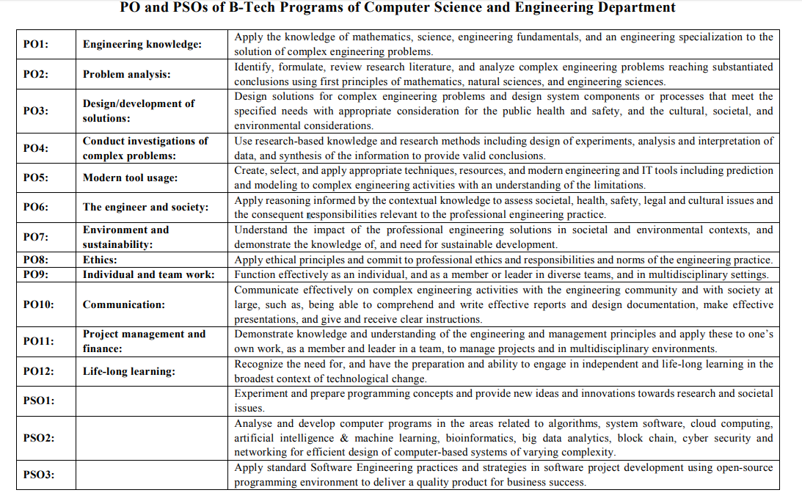
S C H O O L O F E N G I N E E R I N G & T E C H N O L O G Y D E P A R T M E N T O F C O M P U T E R S C I E N C E A N D E N G I N E E R I N G

Slide 6
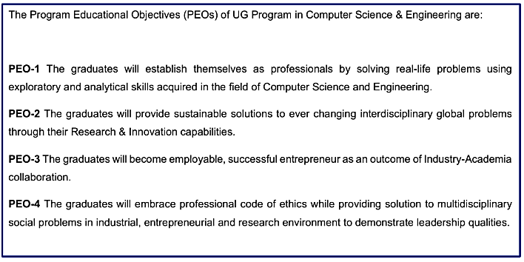
S C H O O L O F E N G I N E E R I N G & T E C H N O L O G Y D E P A R T M E N T O F C O M P U T E R S C I E N C E A N D E N G I N E E R I N G
Program Educational Objectives (PEOs)

Slide 7
S C H O O L O F E N G I N E E R I N G & T E C H N O L O G Y D E P A R T M E N T O F C O M P U T E R S C I E N C E A N D E N G I N E E R I N G
Evaluation methods
S.No. | CA Components | Marks | Remarks
1 | Quiz | 25 | 5 Quiz of 3 Marks Each
2 | Projects/Presentation/Case Study | 50 | Any one component of CA can be used. But, this must be part of Evaluation Scheme in syllabus so it will be known to all including students from the beginning.
3 | Classroom Participation/ MOOC/ Assignment | 25 | Five Evaluations per student uniformly distributed over the Semester as per Academic Calendar Oral Questioning on understanding in lecture, Group Participation on topic, Demonstration/problem solving on white board, Peer Reviews
Total CA Marks |  | 100

Slide 8
S C H O O L O F E N G I N E E R I N G & T E C H N O L O G Y D E P A R T M E N T O F C O M P U T E R S C I E N C E A N D E N G I N E E R I N G
Evaluation Method Conti..
Subject Weightage Distribution | CA | MTE | ETE
 | 100%
5 quizzes will be conducted
5 Assignments will be given
Project/ Case Study/ Presentation
Regular Class Performance
Certification/MOOC course based Evaluation

Slide 9
S C H O O L O F E N G I N E E R I N G & T E C H N O L O G Y D E P A R T M E N T O F C O M P U T E R S C I E N C E A N D E N G I N E E R I N G
List of students
As per Attendance List

Slide 10
S C H O O L O F E N G I N E E R I N G & T E C H N O L O G Y D E P A R T M E N T O F C O M P U T E R S C I E N C E A N D E N G I N E E R I N G
Attendance criteria
Attendance Criteria
Attendance | Continuous Assessment | Mid-Term Examination | End-Term Examination
 | Mandatory – 75%

Slide 11
S C H O O L O F E N G I N E E R I N G & T E C H N O L O G Y D E P A R T M E N T O F C O M P U T E R S C I E N C E A N D E N G I N E E R I N G
Attendance criteria Conti…
As you all are aware that while a minimum of 75% attendance is required in each course to be eligible to appear for the End Semester Examination, Students are expected to have 100% attendance.
Please find the attendance requirement rule mentioned below:
Attendance will be monitored course-wise.
A student will be required to have at least 75% attendance in a course, to be eligible to appear in end-term examination (ETE).
Irrespective of whether a student has registered late or on time, calculation of attendance shall be based on all the classes held, and not from the date on which the student has registered, unless otherwise decided by the Registrar in the case of fresh entrants only.

Slide 12
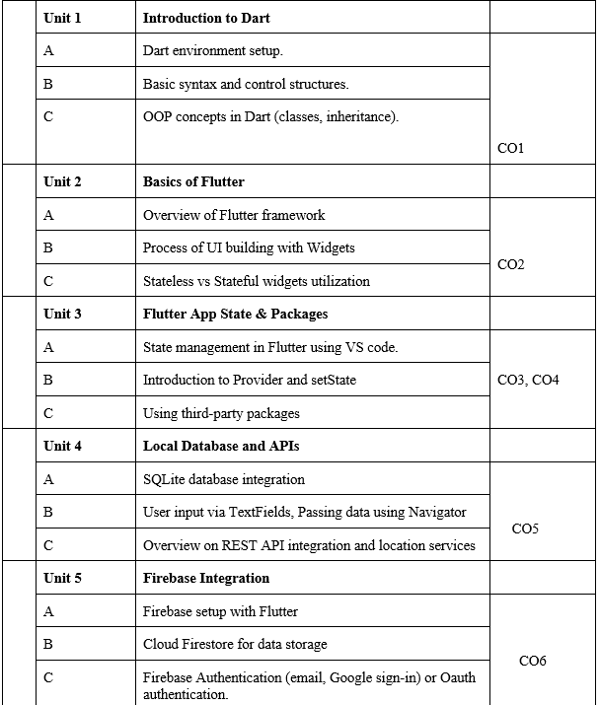
S C H O O L O F E N G I N E E R I N G & T E C H N O L O G Y D E P A R T M E N T O F C O M P U T E R S C I E N C E A N D E N G I N E E R I N G
Syllabus
CSE251 THEORY OF COMPUTATION
(shared to the students)

Slide 13
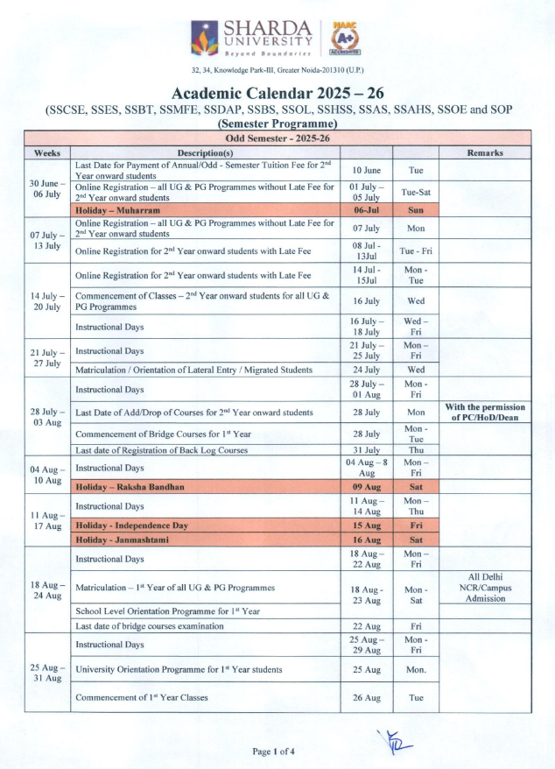
S C H O O L O F E N G I N E E R I N G & T E C H N O L O G Y D E P A R T M E N T O F C O M P U T E R S C I E N C E A N D E N G I N E E R I N G
Academic Calendar
(shared to the students)

Slide 14
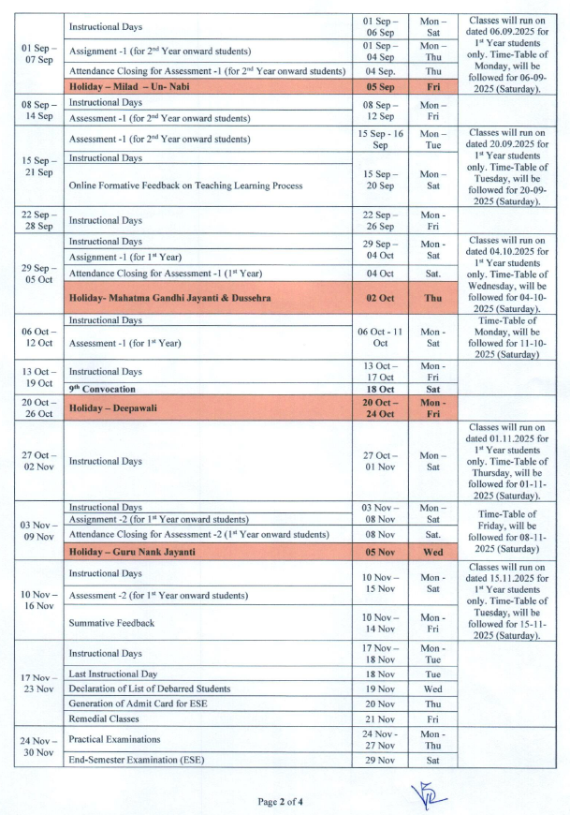
S C H O O L O F E N G I N E E R I N G & T E C H N O L O G Y D E P A R T M E N T O F C O M P U T E R S C I E N C E A N D E N G I N E E R I N G

Slide 15
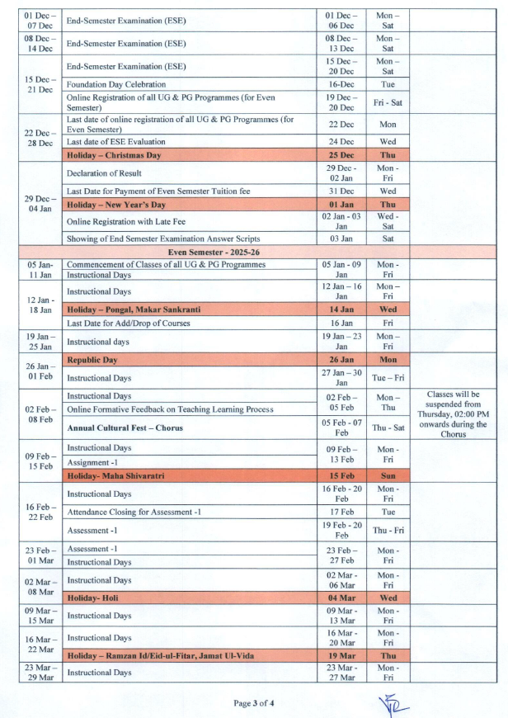

Slide 16
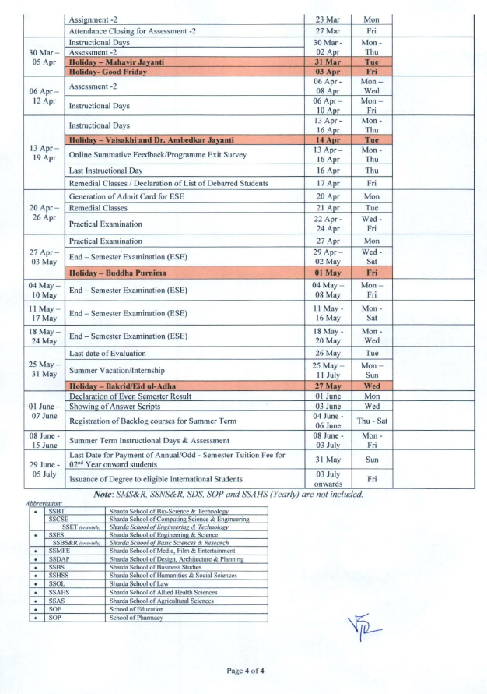

Slide 17
S C H O O L O F E N G I N E E R I N G & T E C H N O L O G Y D E P A R T M E N T O F C O M P U T E R S C I E N C E A N D E N G I N E E R I N G
Scope of the subject in Computer Science & Engineering, its prerequisite and other related subjects.
The course plays a vital role in Computer Science & Engineering by empowering students to build high-performance, cross-platform mobile applications using a single codebase. It introduces Dart programming and essential UI/UX principles.
The prerequisite for this course is basic knowledge of object-oriented programming and problem-solving skills.
This subject is closely related to Mobile Computing, Human-Computer Interaction, and Software Engineering, as it involves designing user interfaces, managing states, and integrating backend services. Flutter's growing industry demand makes this subject valuable for careers in mobile app development, UI engineering, and full-stack development across Android, iOS, and web platforms.

Slide 18
S C H O O L O F E N G I N E E R I N G & T E C H N O L O G Y D E P A R T M E N T O F C O M P U T E R S C I E N C E A N D E N G I N E E R I N G
Importance of the subject in Industry/Entrepreneurial Ventures
The major reasons about the importance of the subject listed below;
Cross-Platform Development: Enables building Android, iOS, web, and desktop apps using a single codebase.
Cost Efficiency: Reduces development time and cost, ideal for startups and small teams.
Faster Time-to-Market: Suitable for rapid prototyping and launching MVPs (Minimum Viable Products).
Industry Demand: High demand for Flutter developers across sectors like fintech, e-commerce, and edtech.
Entrepreneurial Flexibility: Empowers individuals to build full-featured apps independently.
Native Performance: Provides near-native performance with a rich UI experience.
Open Source and Community Support: Backed by Google and supported by a vast developer community.

Slide 19
S C H O O L O F E N G I N E E R I N G & T E C H N O L O G Y D E P A R T M E N T O F C O M P U T E R S C I E N C E A N D E N G I N E E R I N G
Any other required material to be show to the students: Time Table
As per Time Table shared by the
department

Slide 20
S C H O O L O F E N G I N E E R I N G & T E C H N O L O G Y D E P A R T M E N T O F C O M P U T E R S C I E N C E A N D E N G I N E E R I N G
Know your teacher
Dr. Keshav Kaushik is an Associate Professor of Center of Cyber Security & Cryptology, Sharda School of Computer Science & Engineering, Sharda University, Greater Noida, India.
Cabin: 9, Room No: 302, Block-3
Contact: 9466626434

Slide 21
S C H O O L O F E N G I N E E R I N G & T E C H N O L O G Y D E P A R T M E N T O F C O M P U T E R S C I E N C E A N D E N G I N E E R I N G
THANK YOU

